Slide 1

Operations Plan

Slide 2
Outline
Location & Physical Facilities
Supply Channels
Production Processes
Risk Management
Customer Service
Policies
Forms & Contracts
Record Keeping
Operations

Slide 3

Physical Facilities
Location
  Visibility
  Traffic Volume
  Access
  Parking
Operations

Slide 4
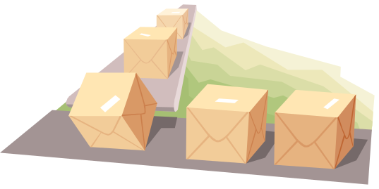

Physical Facilities
Inventory Management
Production Equipment
Production Processes
Office Equipment
Utilities
Merchandise Display
Operations

Slide 5

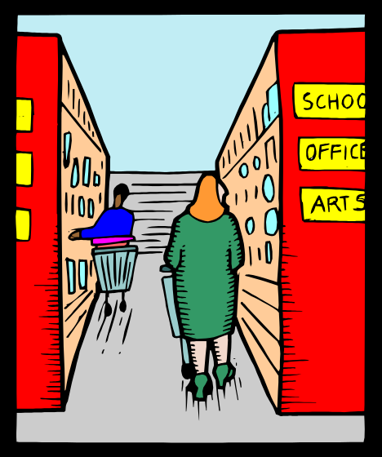
Physical Facilities
Office Equipment
Utilities
Merchandise Display
Operations

Slide 6

Supply Channel
Source of Goods
Supplier Alternatives
Critical Dependencies
Operations

Slide 7


Production Processes
Necessary Equipment
Supplies
Operations

Slide 8

Risk Management
Possibility of an unfavorable outcome
  Product and Production (inc. Crops)
  Market (inc. Price)
  Financial
  Personnel
  Legal and Liability
  Casualty
  Environmental
Operations
Notes:
Almost always a tradeoff between risk and return, with expected higher returns only possible at the expense of accepting higher risks.
Product & Production – capacity, components, costs
Market – demand, competition
Financial – credit extended, loans, changes in interest
Personnel – productivity, training, malfeasance
Legal & Liability – breaking laws, accidents
Casualty – fire, theft
Environmental – spills, acts of God (floods, wind…)

Slide 9

Primary Sources of Risk
Controllable
  Product
  Production
  Employees
  Premises
Uncontrollable
  Acts of God
  Competitive Actions
  Market Fickleness/Changing Trends
Manage the controllable; mitigate the uncontrollable
Operations

Slide 10

What to do about Risk?
Risk Identification & Assessment
Define Ability to Bear Risk
Avoid/Prevent/Reduce/Mitigate
Limit
Transfer
Assume
Operations

Slide 11


Risk Chain Concept
Source of Loss
Hazard Severity
Extent of Loss
Salvage
Eliminate sources of fire
-Engines
-Electricity
Reduce hazard
-Fire retardant materials
-Inspections
Reduce effect of fire
-Sprinkler system
-Fire alarms
-Response Training
Maximize Salvage
-Quick Action
-Avoid risk propagation
Appropriate actions can be taken anywhere in the chain
Operations

Slide 12

Risk Assessment
Professional independent insurance agent
Recognize risks - risk analysis questionnaire/survey
  Property losses
  Business interruption
  Liability exposure
  Key person loss
  Automobile
  Employee injury
Quantify exposure
Operations
Notes:
Estimate the frequency of the potential loss. Probability analysis. This technique may require more information than is available, so another approach is to construct probability trees and explore the branches. As with the development of a business plan, the value is in the process.
This technique is most valuable for the market risks.
Estimate the severity of the loss.
Example. Nursery stock grower has opportunity to add a new plant – a columnar containerized apple tree.

Slide 13

Reducing Risk
Avoid risky activities
Diversification
Hazard control
Personnel Training
Historical extrapolations – make changes incrementally
Hedge inputs
Spread sales
Effective contracts
Operations

Slide 14
Limiting Risk
Document processes
Provide training and oversight
Ensure legal compliance in every activity
Product Guarantee/Warranty
Select a business structure that limits liability
Asset management
Transfer risk above your threshold of tolerance
Operations

Slide 15
Liability vs Negligence
Liability –
Any legal responsibility, duty, or obligation
Negligence –
Failure to live up to a required duty of care
Gross negligence –
Extreme carelessness showing willful or reckless disregard for safety or property of others
Operations
Notes:
Negligence defines degree of damages that will be due from the fault. Damages range from reimbursement of actual economic loss to treble and punitive damages.
Required duty care is generally recognized as the actions that a reasonable and informed person would take.
Discussion – Titanic. Iceberg warnings yet Titanic steamed ahead to break crossing record. Not enough lifeboats for all passengers.

Slide 16

Customer Liable?
Customer rents equipment
Equipment vandalized at customer site
Renter Generally Liable
Manage the Financial Risk
  Offer Damage Insurance
  Contract “return good condition excepting normal wear/tear.”
Operations
Notes:
Negligence defines degree of damages that will be due from the fault. Damages range from reimbursement of actual economic loss to treble and punitive damages.
Required duty care is generally recognized as the actions that a reasonable and informed person would take.
Discussion – Titanic. Iceberg warnings yet Titanic steamed ahead to break crossing record. Not enough lifeboats for all passengers.

Slide 17



Liable or Negligent?
Titanic
Operations
Notes:
Negligence defines degree of damages that will be due from the fault. Damages range from reimbursement of actual economic loss to treble and punitive damages.
Required duty care is generally recognized as the actions that a reasonable and informed person would take.
Discussion – Titanic. Iceberg warnings yet Titanic steamed ahead to break crossing record. Not enough lifeboats for all passengers.

Slide 18

Transfer Risk
Insurance
Contracts
  Hold harmless agreements
  Sales contracts
  Independent contractors or service providers rather than employees
Operations

Slide 19

Insurance
Pooling of risk to a large enough population to predict losses
Cost of insurance is the amortized loss plus underwriter profit
Deductible is the amount of risk you assume, remainder is transferred
Most any risk can be insured…for a price
Operations

Slide 20
Business Insurance
Employees
  Required
    FICA
    Workers’ compensation
    Unemployment
  Optional
    Disability
    Health (medical/dental/vision)
    Key employee life
Property
Home Office
Auto
Liability
Business interruption
Crop insurance
Officers and Directors
Operations

Slide 21

Contracts
Contract – agreement that can be enforced in court
Requirements – Must have all 4
  Agreement
  Consideration
  Capacity
  Legality
Operations

Slide 22
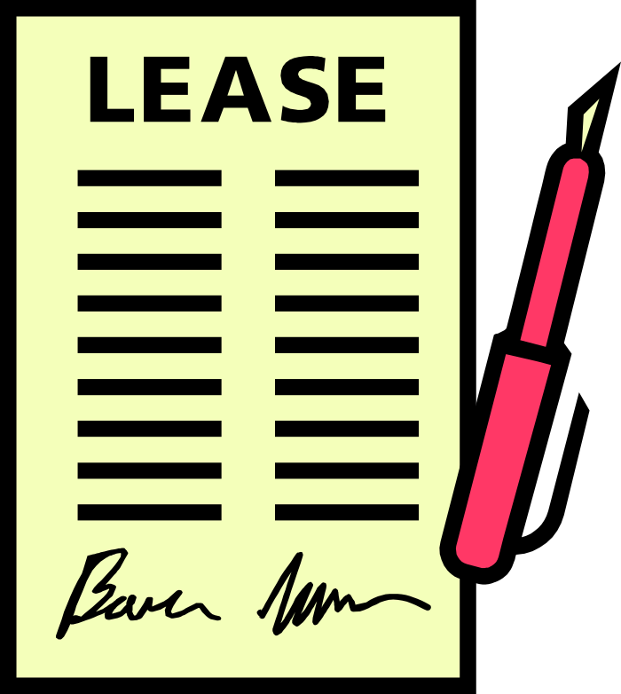
Common Contract Pitfalls
Invalid contracts
Unintended employment contracts
Quasi contracts
Statute of Frauds
Operations

Slide 23

Essential Contracts
Bid/Quote/Estimate
  Work Included
  Work Excluded
  Materials Purchase
  Mech. Liens
Bill of Sale
  Payment Receipt
  Policies
Operations

Slide 24

Critical Policies
Bid/Estimate
  Credit
  Payment Terms
Part of Bill of Sale
  Refunds
  Returns
Operations

Slide 25

Customer Service
On average, a business will lose half of its customers in five years
Generating a new customer costs five times more than keeping a current one
Long time customers spend more with your business
Operations

Slide 26
Customer Service
Happy
Profitable
Repeat Business
Referrals
Current
Customer
Dissatisfied
May Buy From
Competitor Next Time
New Customer
High Acquisition Cost
Operations

Slide 27

Customer Service
Key Components
Basic Product/Service
Customer Service Processes
Customer Relationship Management
Recovery Process
Operations

Slide 28

Customer Service
Basic Product/Service Wants
Pre-customized to meet their needs
No assembly required
No hassles returns
Work perfectly
Feel good about acquiring it
Operations

Slide 29

Customer Service
Customer Service Processes
Fairness
Friendliness
Understanding
Options
Information
Exceed Expectations
Responsiveness
Treat Customers as Most Important Part of Your Business
Operations

Slide 30

Customer Service
Customer Relationship Management
Identify your best customers
Build database of habits
Regularly contact
Advance notices
Specials/discounts
Recognize life events
Make Best Customers a Part of Your Business
Operations

Slide 31

Customer Service
Recover Dissatisfied Customers
Average customer with a complaint will tell 10 people
13% will tell more than 20 people!
For every complaint, 26 customers didn’t complain
Operations

Slide 32

Customer Service
Recover Dissatisfied Customers
70% of complainers will return if issue resolved
95% return with on-the-spot resolution
Operations

Slide 33

Customer Service
Recover Dissatisfied Customers
Deal with Issues Immediately
Never belittle
Don’t pass the buck
Empower “front line” to resolve
Actively Solicit Feedback
Operations

Slide 34
Record Keeping
Your Records are an Asset
  Measure Progress of Your Business
  Essential to Prepare Financial Statements
  Track Source of Revenues
  Identify & Justify Deductible Expenses
Operations

Slide 35

Record Keeping
What to Keep?
  Asset Basis
  Business Transactions
    Sales Receipts
    Invoices
    Paid Bills
  Customers
  Employee
  Payroll
  Minutes of Meetings
Archive Process
Back-up Process
Operations

Slide 36

Record Keeping
How Long to Keep?
As Long as Needed to Support Tax Filings
  Income Tax Records – 3 years minimum
  Employment Tax Records – 4 years minimum
  Assets – Life of Asset + 3 years
Non Tax Records
  Employee – Length of Employ + 3 years
  Corporate Minutes - Indefinitely
Operations

